Slide 1




Smart Sandbag for Autonomous Lunar Construction
Michael Villasana
Dr. Jekan Thanga, Department of Aerospace and Mechanical Engineering
Tucson, Arizona
April 20th, 2024

Slide 2
Introduction
NASA's Artemis program seeks to return humans to the Moon and establish a permanent presence, serving as a foundation for future Mars missions.
The program aims to develop a sustainable lunar economy, utilizing lunar resources as a stepping stone for further space exploration.
Constructing lunar infrastructure presents a significant challenge due to the harsh lunar environment impeding astronaut work.
Autonomous systems are crucial for lunar construction, enabling the eventual creation of self-sustainable lunar bases.

Slide 3
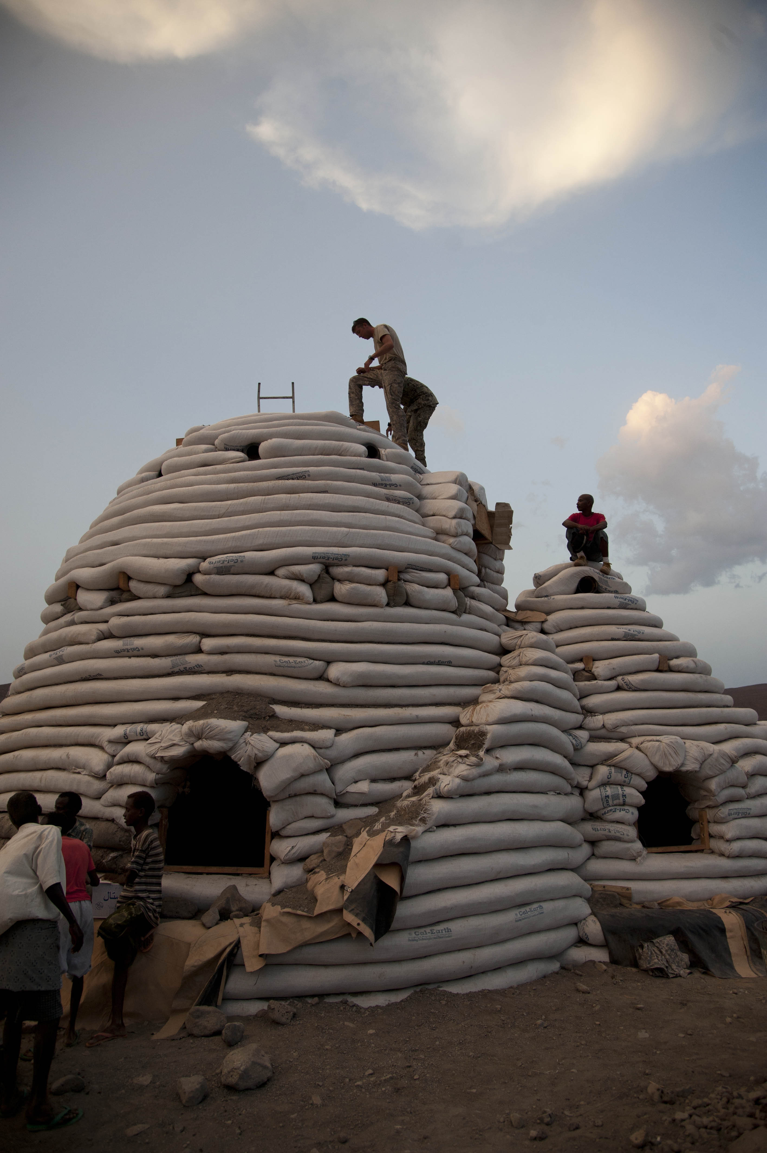
Existing Plans
Currently, there exists plans to begin construction of a Lunar base
A vital structure proposed is the use of Superadobe like structures made of sandbags filled with regolith from the moon
These SMART Sandbags are part of a architecture that can help with maintenance, monitoring and sensing of the lunar base in general.
Cal-Earth polypropylene tubes (sandbags) being used to construct domed structures

Slide 4
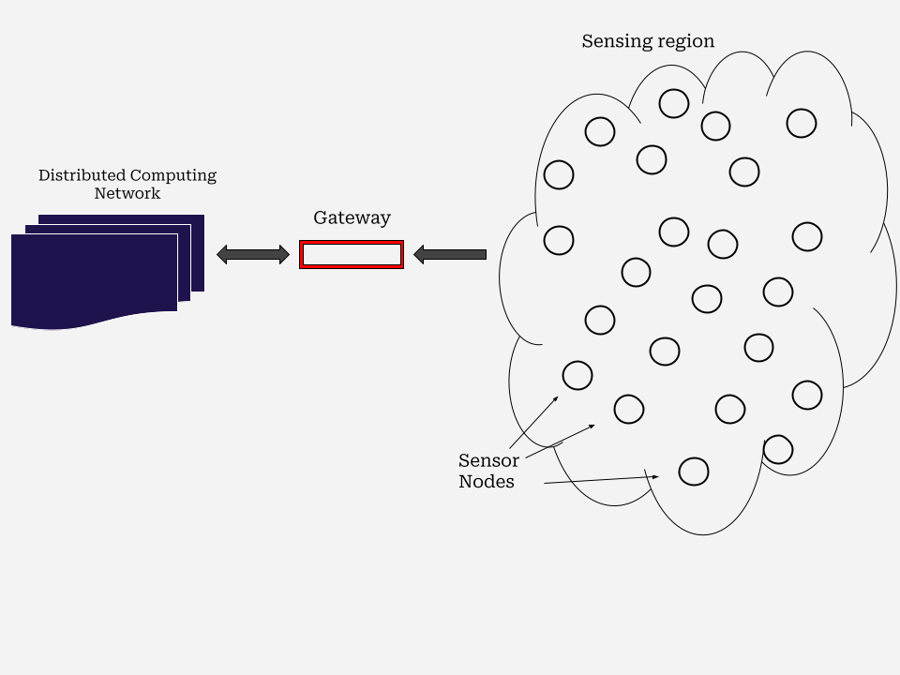
Methods
Two types of networks:
  Distributed Network
  Sensor Network
Distributed Network
  Larger, dispersed network with focus on larger computation
Sensor Network
  Smaller, concentrated network that pertains to monitoring a singular sandbag
Overall Network Architecture for Lunar Base

Slide 5
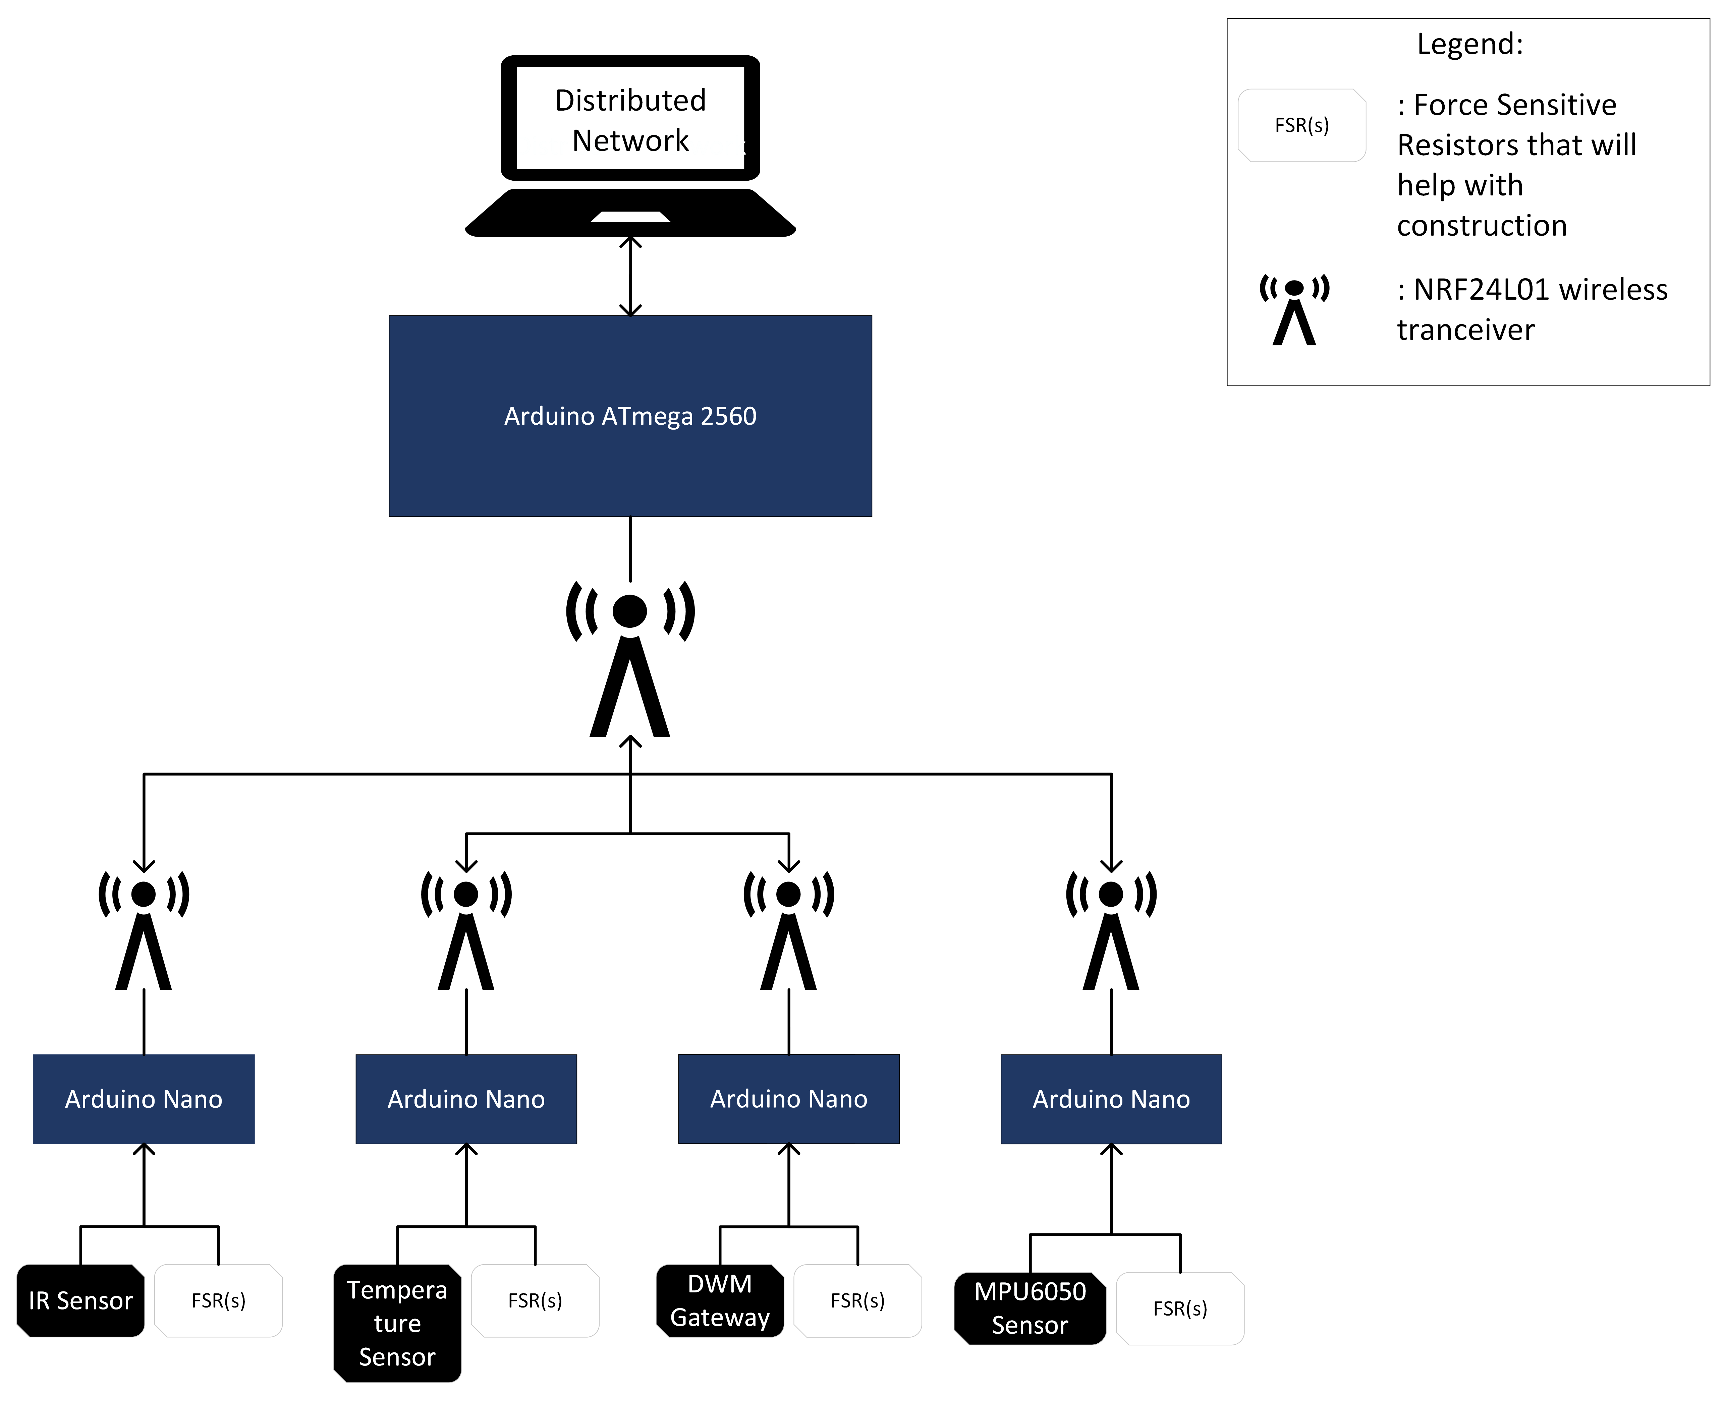
Methods
Focus Area of Work
Sensor Network
  Consists of individual sensors powered by smaller microcontrollers
  Each microcontroller has wireless transmission
  Bigger microcontroller serves as gateway to distributed network

Slide 6
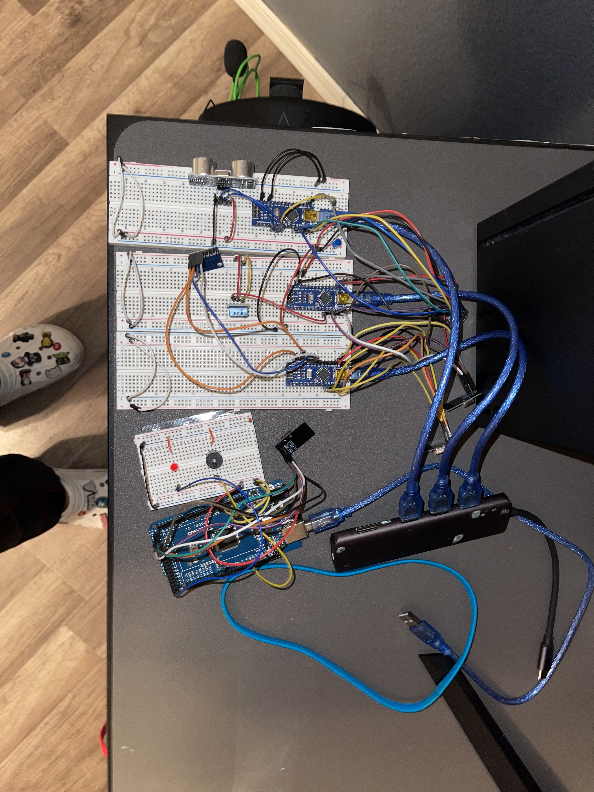
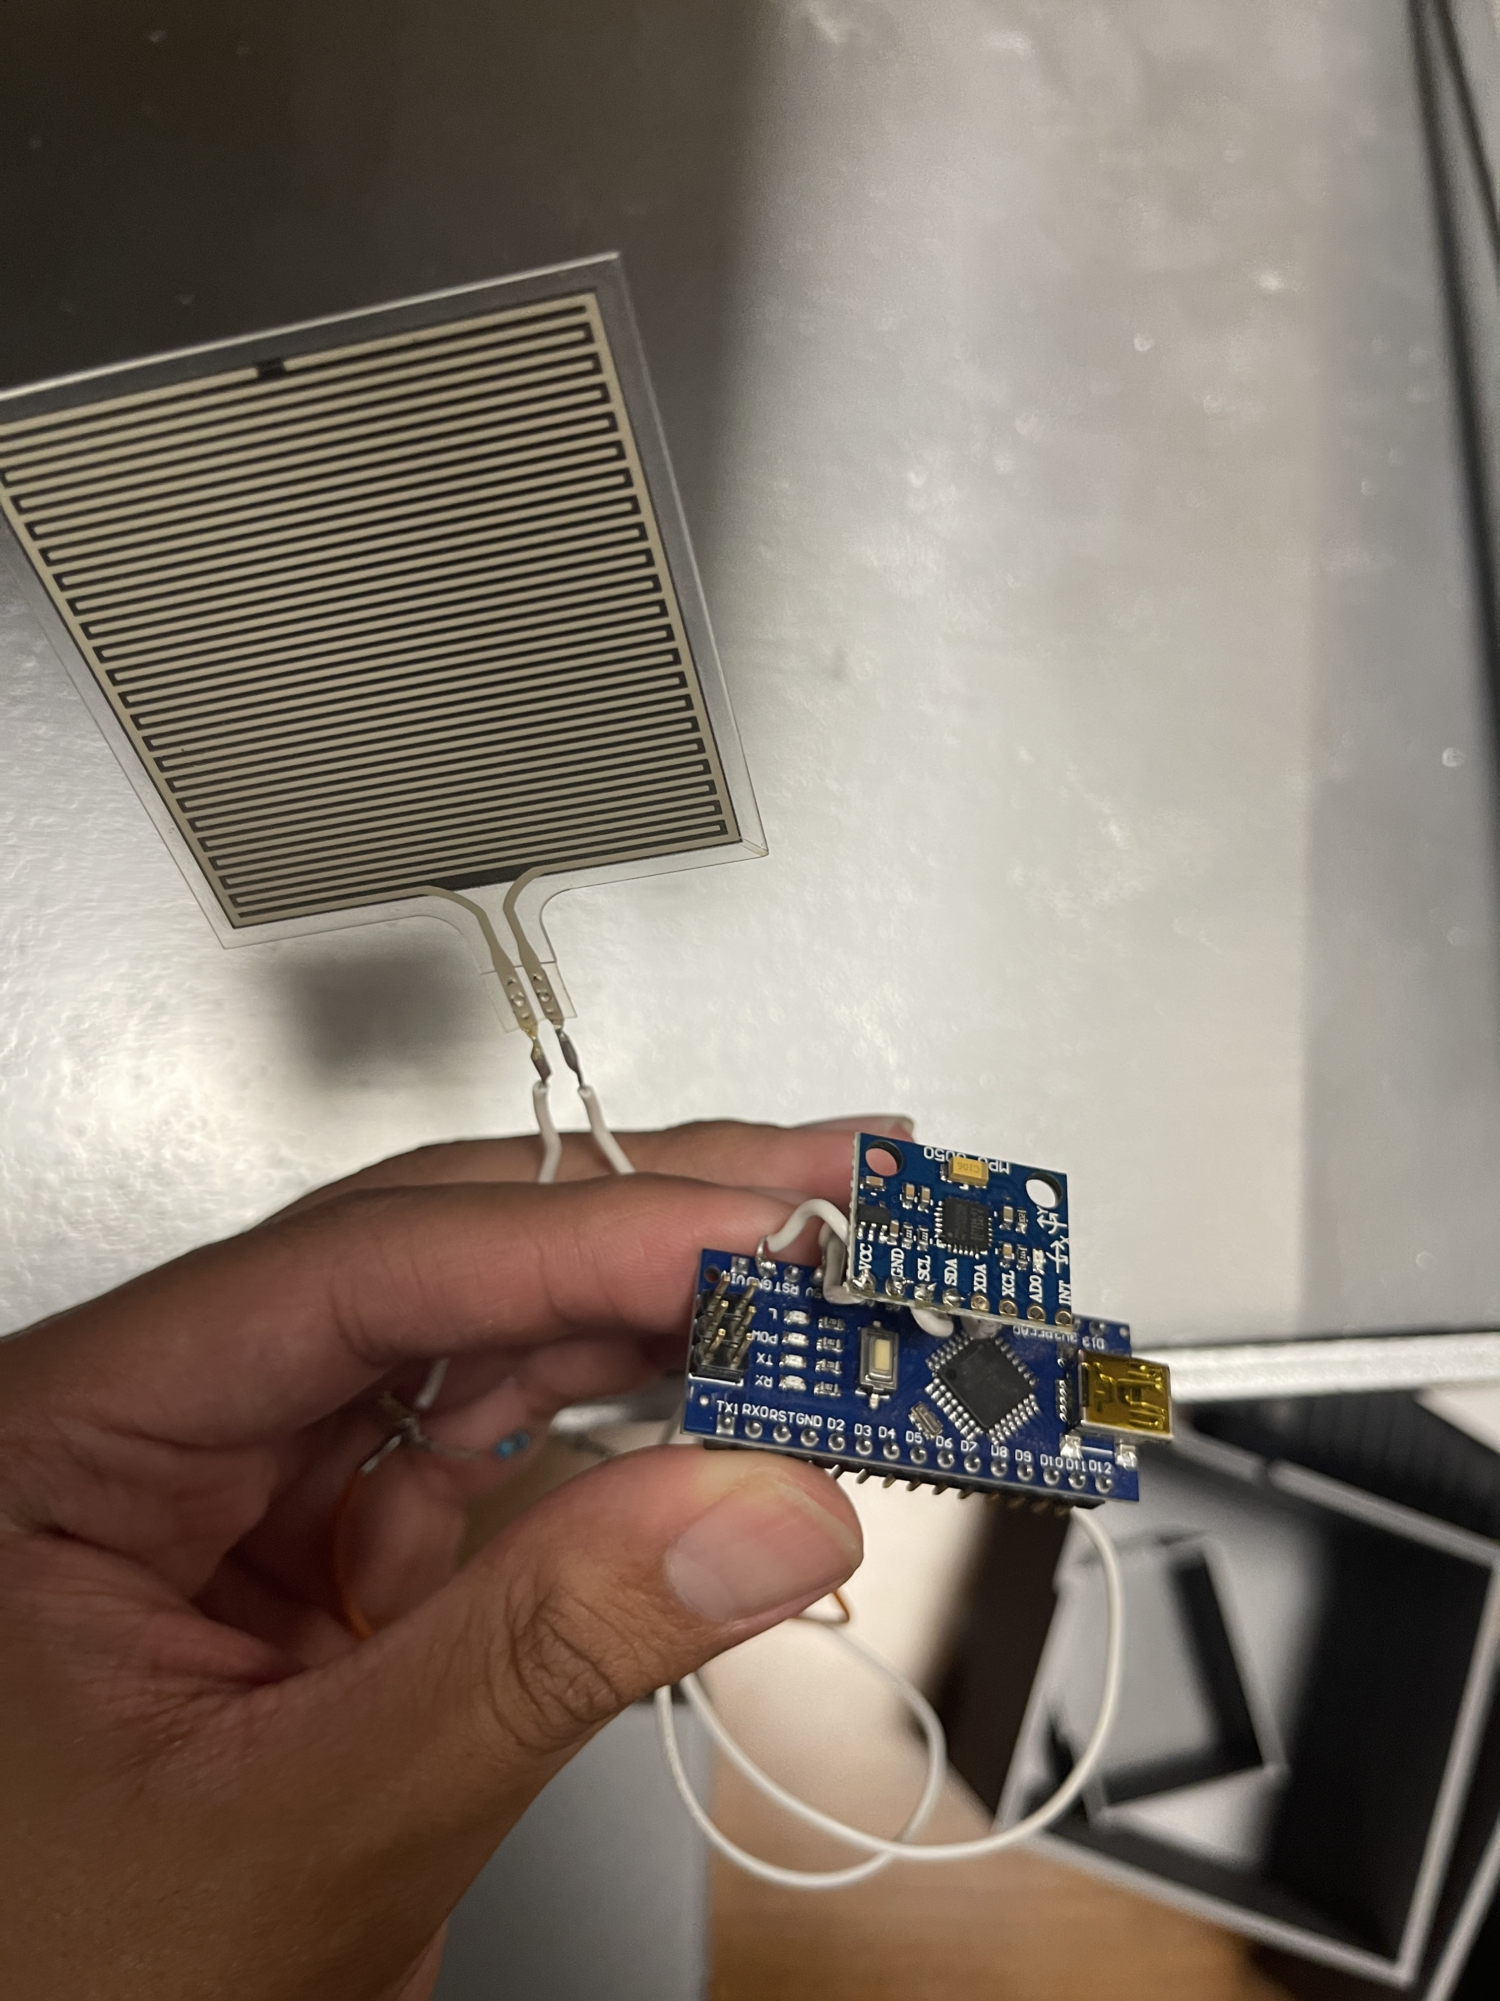
Methods continued
Wireless transmission was achieved using a wireless Transceiver (nRF24L01+)
Orientation Determination was achieved using a Accelerometer / Gyroscope (MPU6050)
Localization was achieved a Ultra-Wide Band module (DWM1001C)
Force sensing was achieved using a Force Sensitive Resistor (FSR)
Proximity sensing wad achieved using an IR Obstacle Avoidance Sensor
Extra Life Support Sensors:
  Temperature sensing was achieved using a Temperature / Humidity sensor (DHT11)
Pictures of hardware

Slide 7
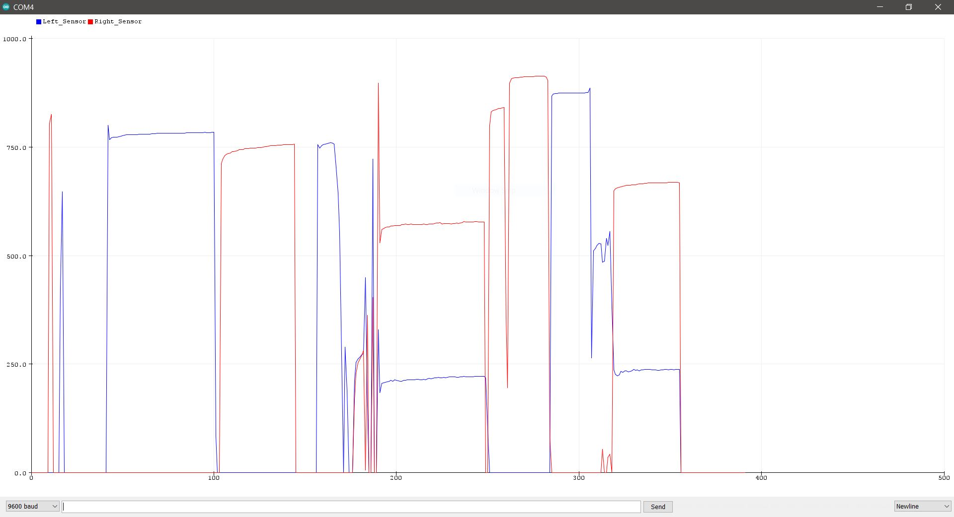
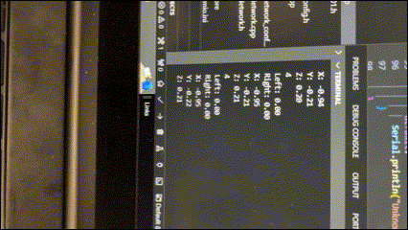
Results
Successful wireless transmission of orientation, position, temperature, proximity, and sagging
Correct predictions to help with construction
  Denoted orientation
  Denoted position
  Denoted sagging
(Top) Results from FSR testing; (Right) Video of live transmission of data from sensor to gateway

Slide 8
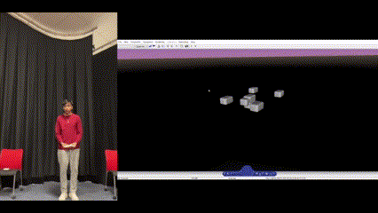
Network Demo
Real time wireless transmission of coordinates, orientation, timing, and pressure.
Simulating the results in Matlab + Unreal Engine.
Systematic layered network of many sensors.
(Top) Matlab VR Demonstration of DWM1001C Real Time Positioning Modules

Slide 9
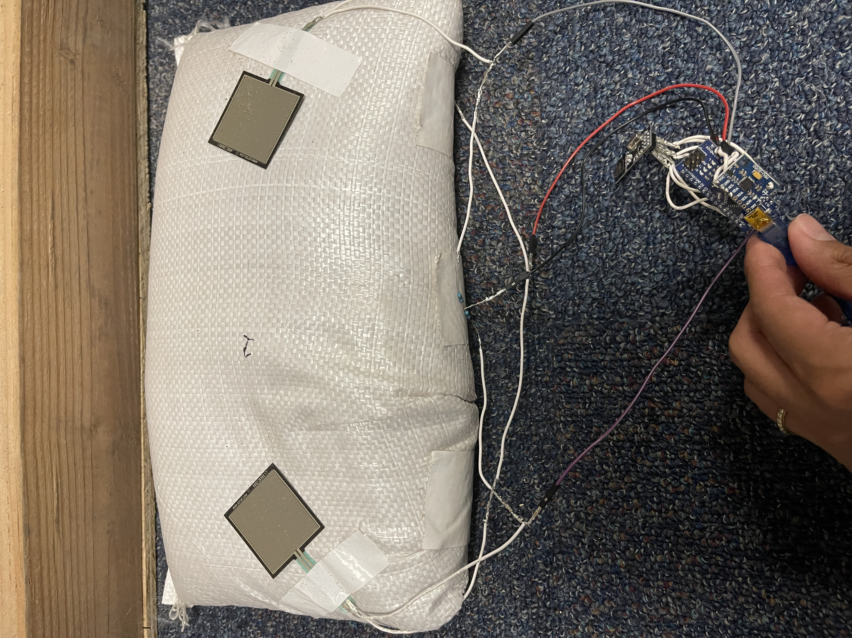
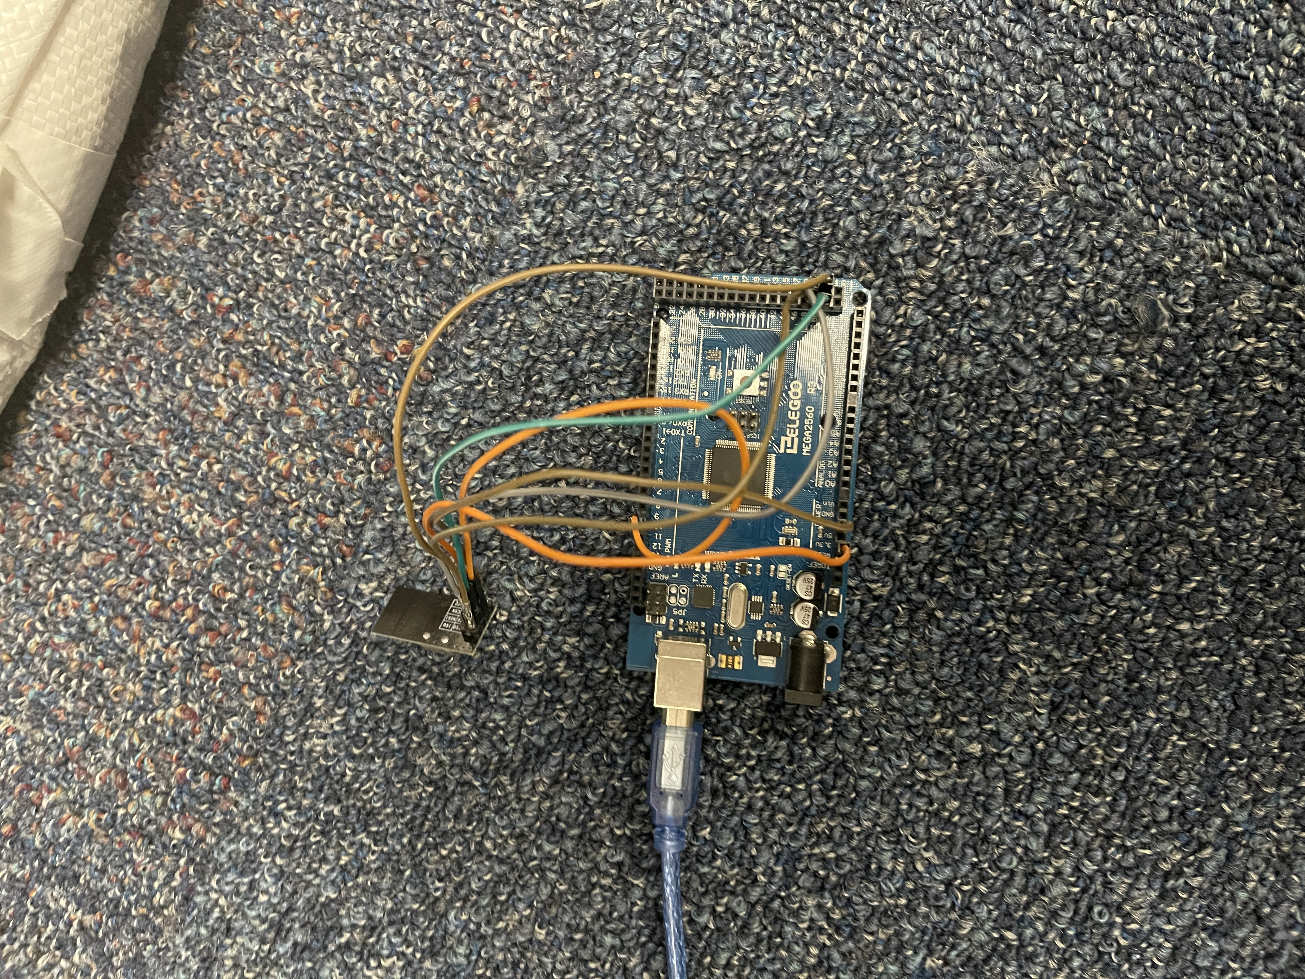
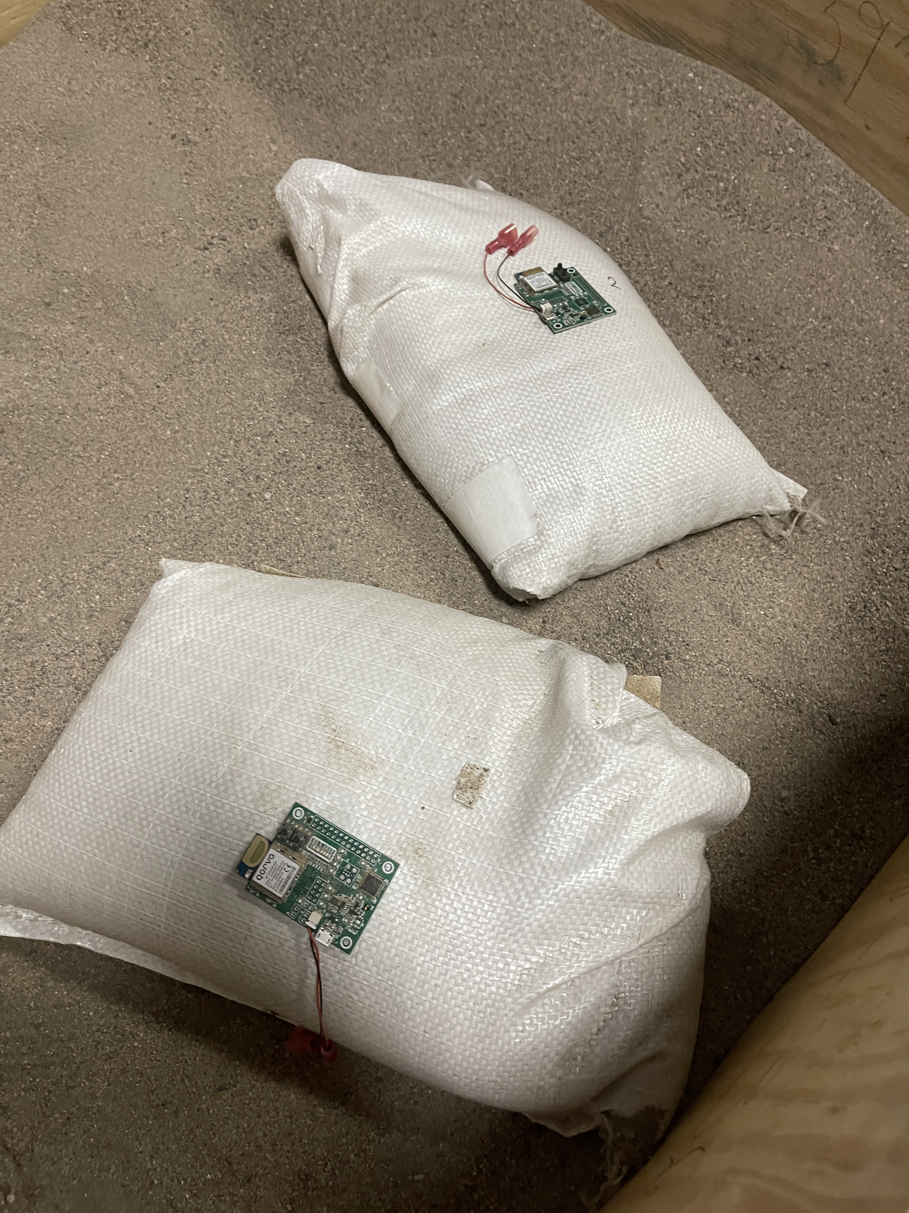
Network Demo
(Left) Setup of MPU6050 and FSRs on Sandbag; (Middle) nRF24L01+ module on gateway ; (Right) DWM1001c modules on Sandbags

Slide 10

Conclusion
Able to localize position of sandbags with 20 cm of error.
Able to detect sagging of sandbag for lunar reparation or construction.
Successful wireless transmission from sensors to external microcontroller
Able to visually simulate in MATLAB VR
AI generated image of a Lunar Base with ongoing operations

Slide 11
Acknowledgements
Supported in part through the Arizona NASA Space Grant Consortium, Cooperative Agreement 80NSSC20M0041.
I would like to express my gratitude to all the Lunar Base Team as well as Dr. Thanga for this opportunity.
I also want to directly thank my grad mentor Siva Muniyasamy.
Lastly, thank you to all the members of the SpaceTREx and Asteroids Lab that I work indirectly with.

Slide 12
Thank you!

